Slide 1
Medication recommendation
By Ibra Cisse
Jason Jensen

Slide 2
Introduction
A database project to collection information about the most common medicine.
Ranking each medicine based on their daily use and how effective they are.
Reviews are based on customers ranking
Ranking can change based on Admin standards, clients, or customer writing reviews

Slide 3
Database And Architecture
For the DML, we decided to use MYSQL.
There are 2 main table categories: Users and Medicine
Users:
Admin: have the most privilege to change anything on the database
Clients: can write, read, and update ranking of medicine based on their use.

Slide 4
Database And Architecture(Cont’)
Medicine:
Symptoms: Users can search based on symptoms that they have.
Medicine: Holds generic and brand names for saved medicine.
Side Effects: Generic name
Reviews: Holds medicine reviews and ratings from clients
Suggestions: Hold suggestions from clients on how to improve the system.

Slide 5
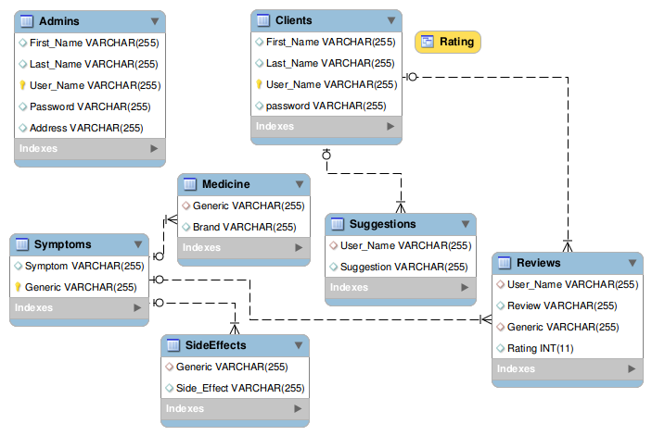
Diagram

Slide 6
Use Case and Results
Administrator login
Client Log in
Client sign up
Administrator creates a table
User asks the highest rated medicine
Client writes a review
Client searches for side effects of medication
Client searches for side effects by symptom

